Slide 1
Hierarchical Abundance Modeling to Inform Oak Savanna Habitat Restoration

Slide 2
Hierarchical Abundance Modeling to Inform Oak Savanna Habitat Restoration
For Minnesota Species in Greatest Conservation Need

Slide 3
University of Minnesota
Fisheries, Wildlife, Conservation Biology
Minnesota Department of Natural Resources
Nongame Wildlife

Slide 4
USFWS State Wildlife Grants Program
MN Department of Natural Resources
MN Herpetological Society
University of Minnesota
Helen Wagner Charitable Foundation

Slide 5
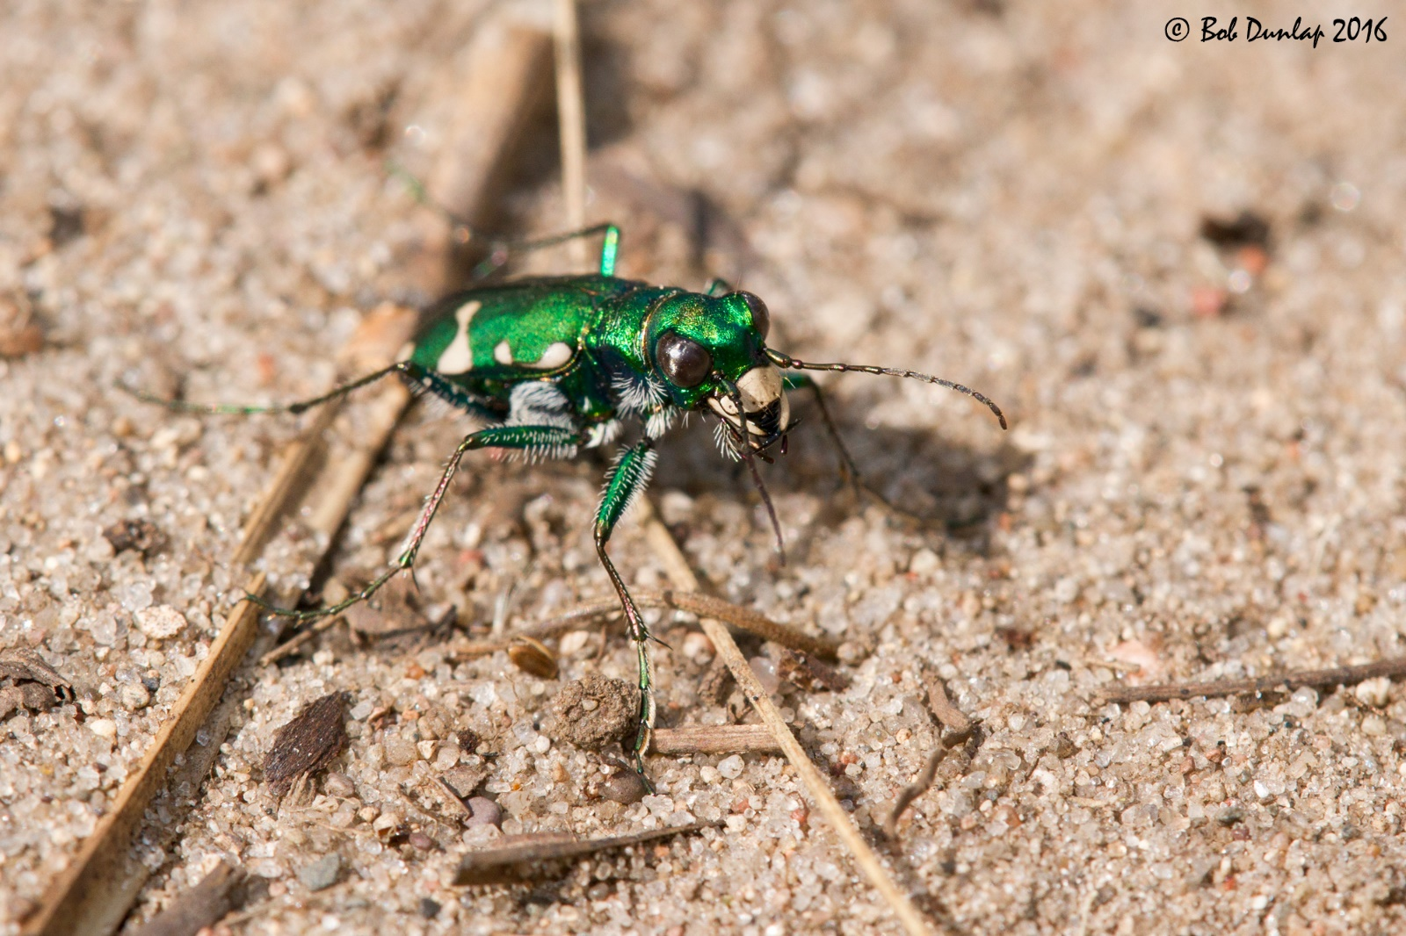
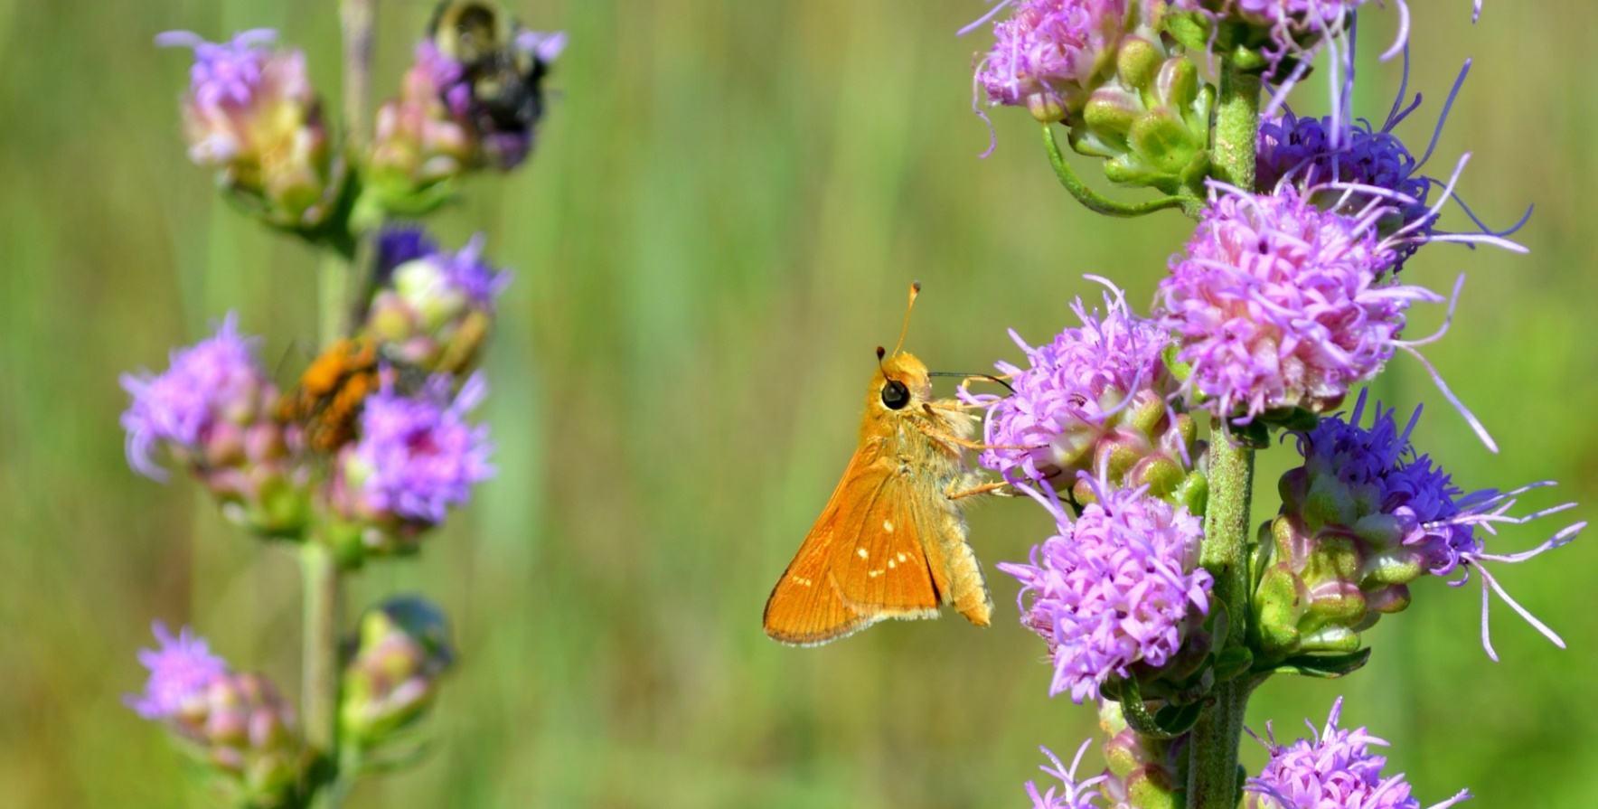
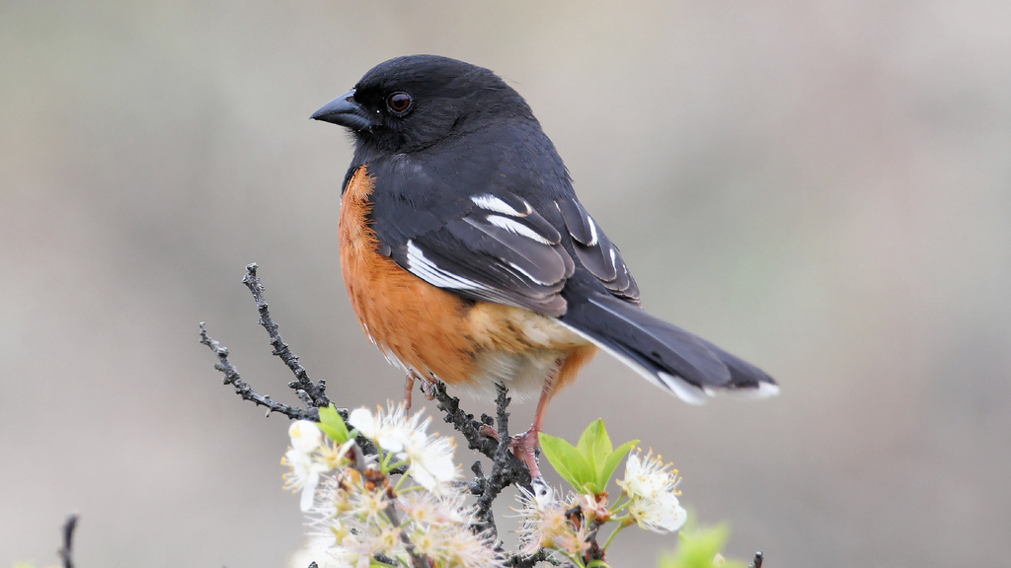
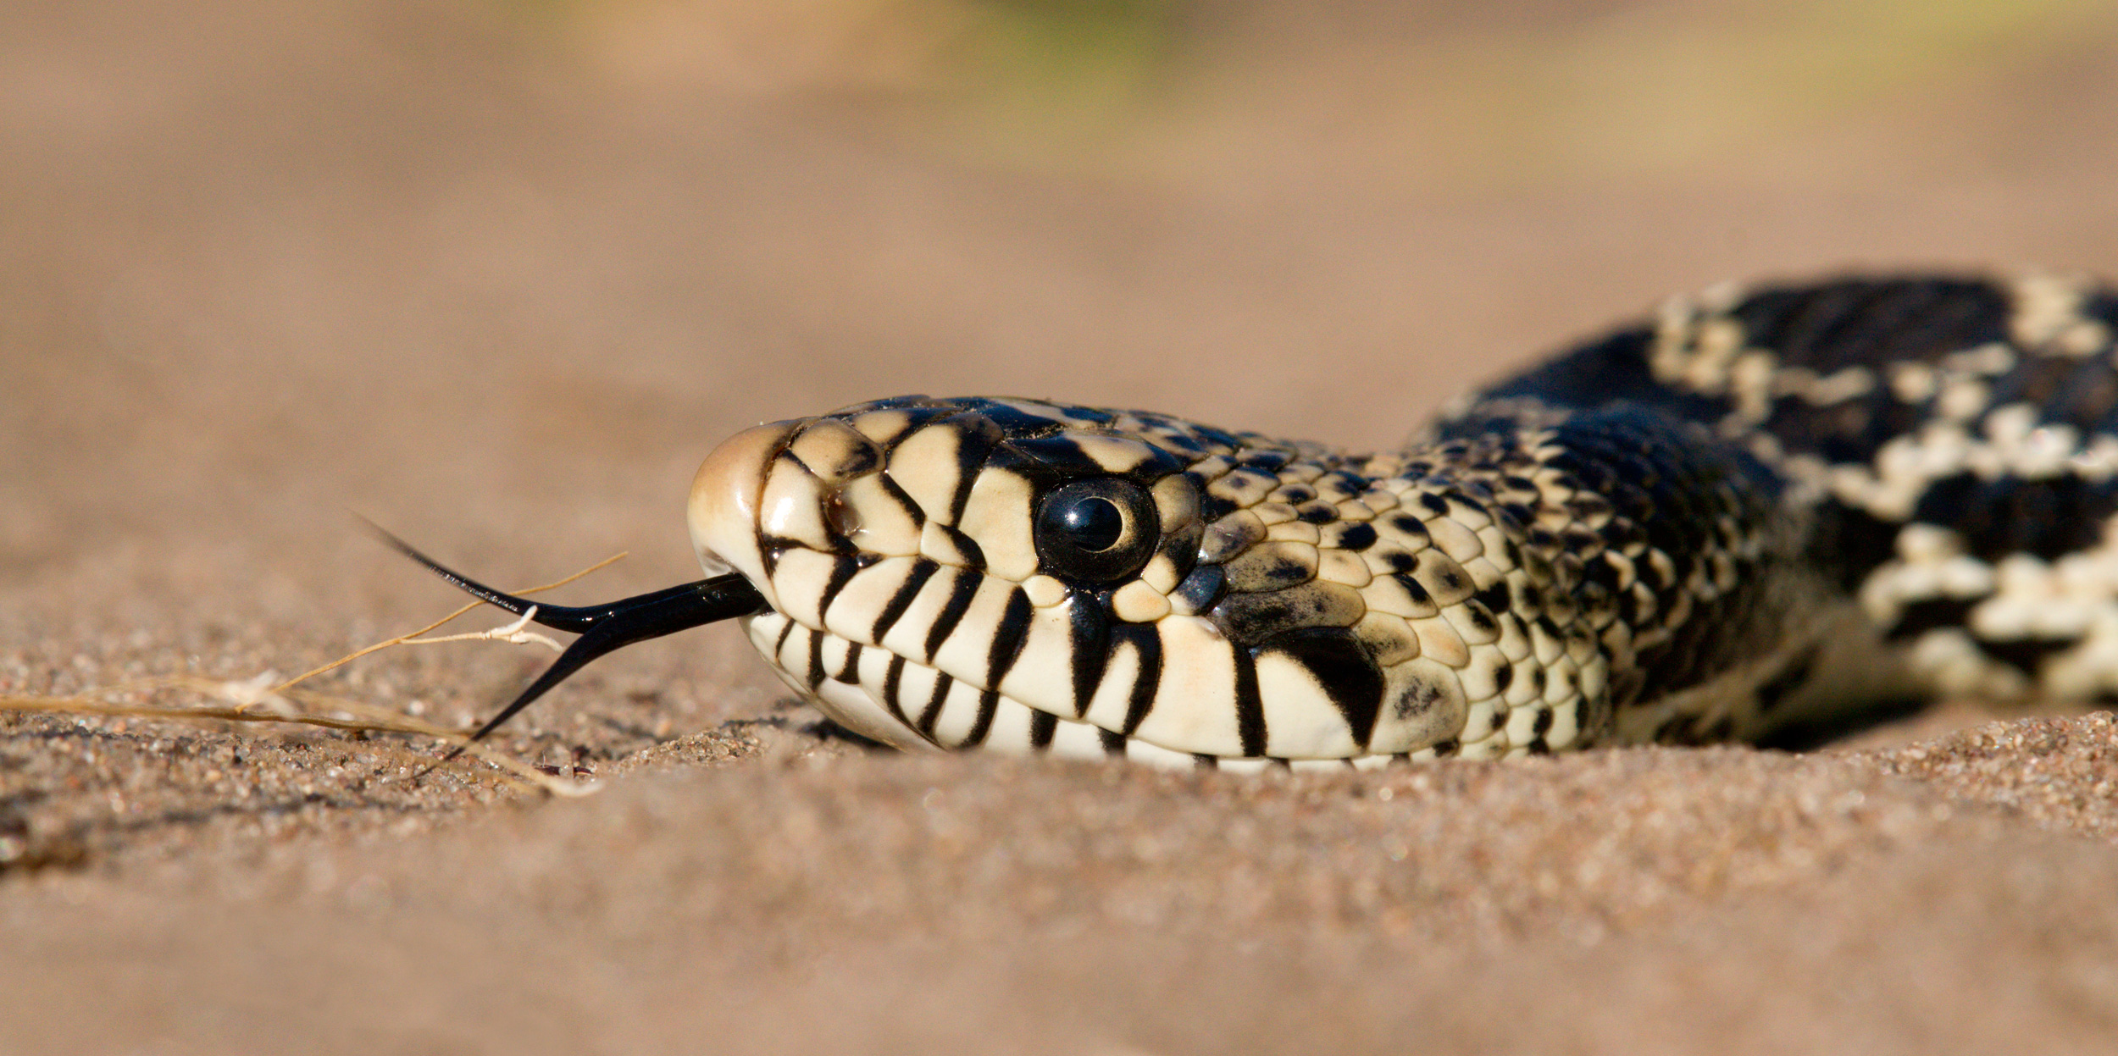
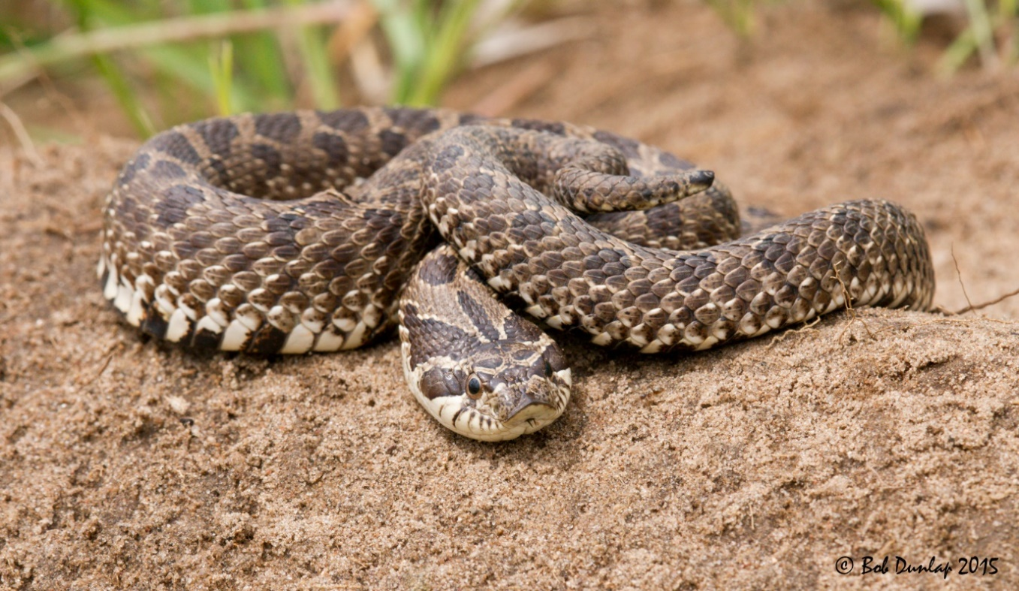
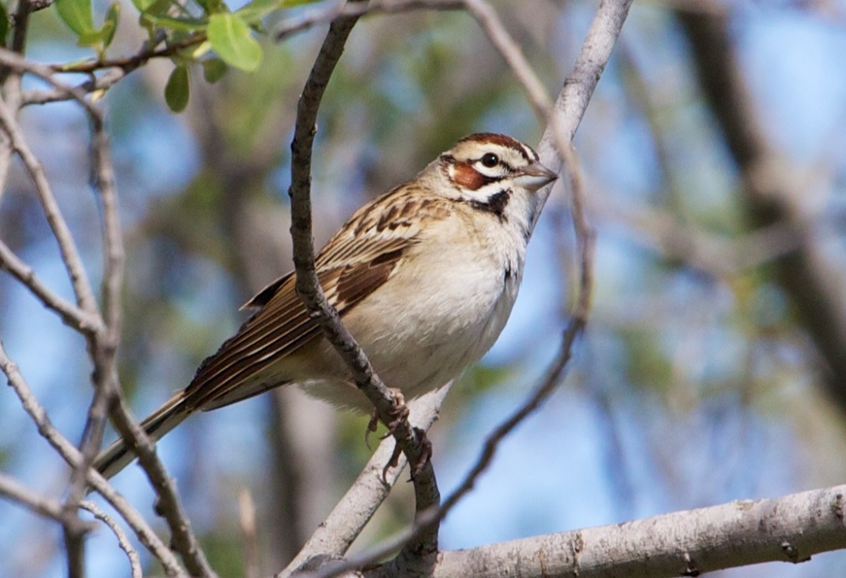
Notes:
These are species that evolved along with the native habitats that we are trying to restore. So, we can use their collective distribution, abundance, and response to management as a way to inform restoration.

Slide 6
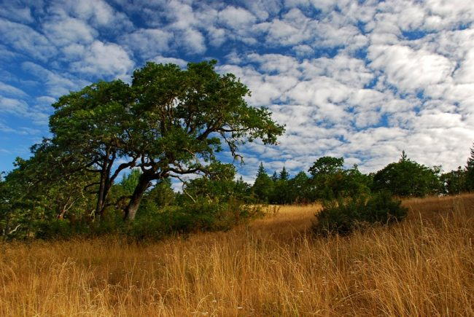

Slide 7
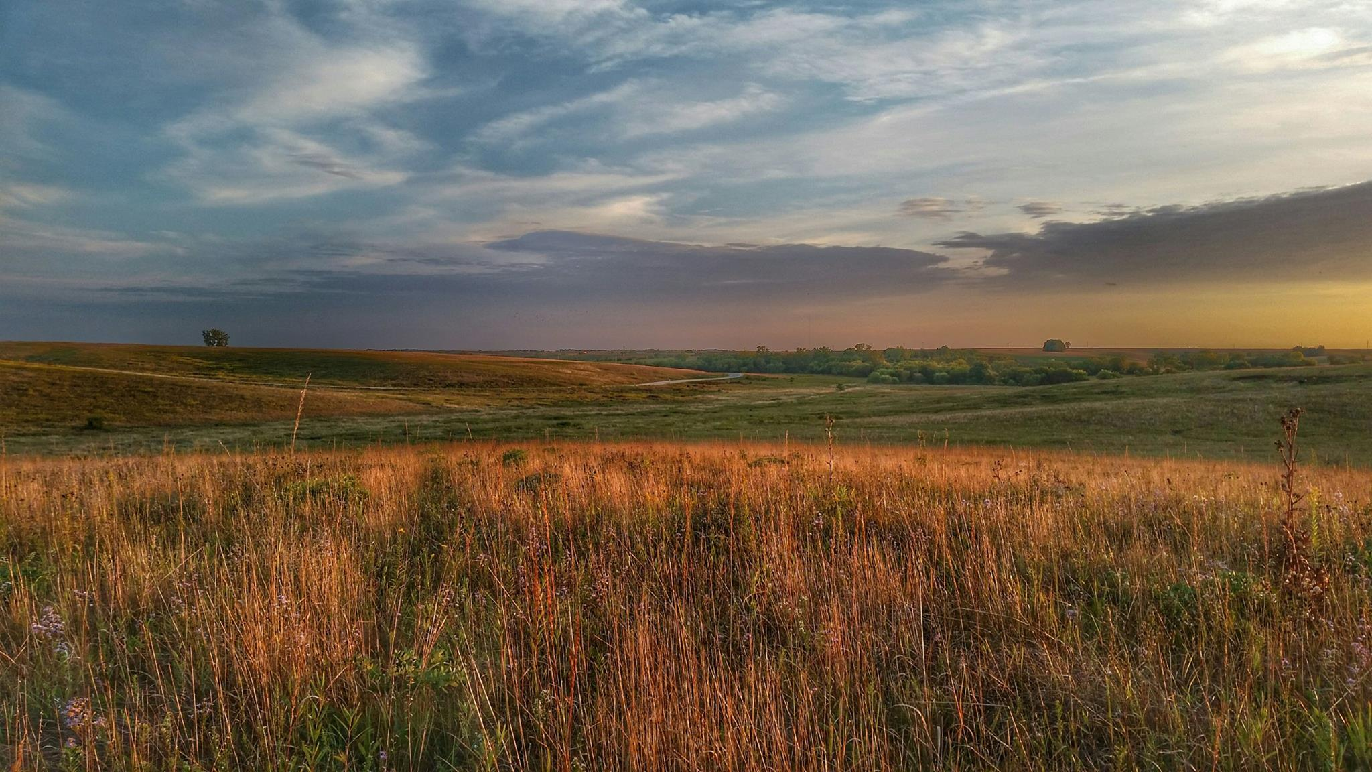

Slide 8
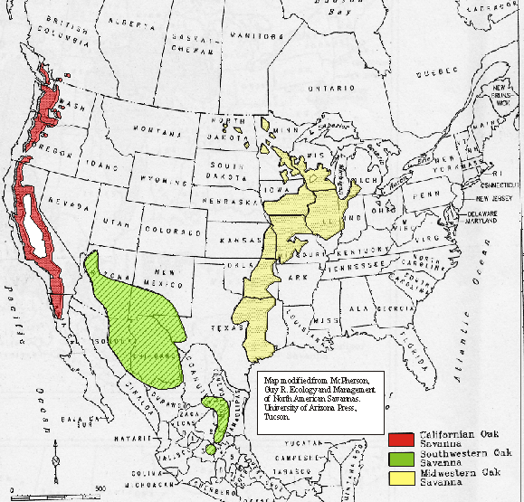
~12,000,000 ha in the Midwest (Nuzzo 1986)

Slide 9
~ 12,000,000 ha
~ 2,600 ha remained
98.98 % loss

Slide 10
~ 12,000,000 ha
~ 2,600 ha remained
< 98.98 %
Nuzzo 1986

Slide 11
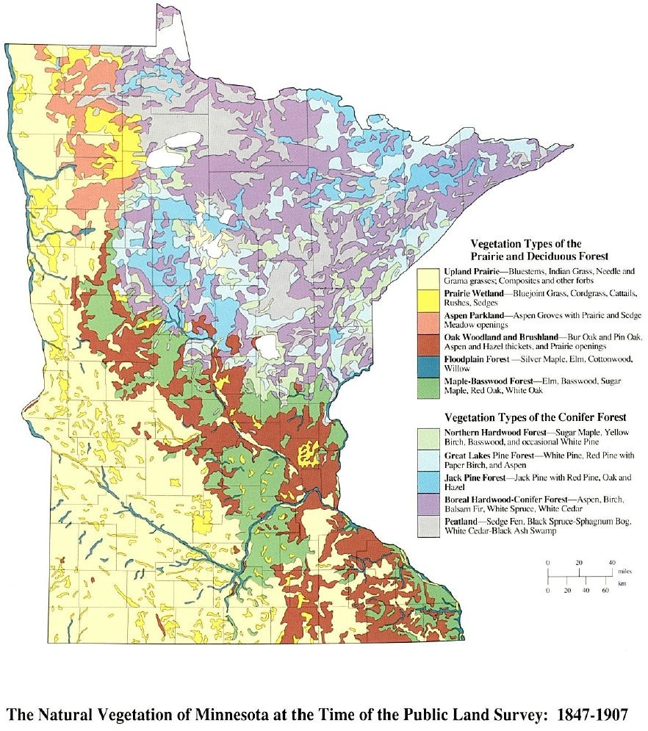
Upland Prairie
Prairie Woodland
Aspen Parkland
Oak Woodland and Brushland
Floodplain Forest
Maple – Basswood Forest
Northern Hardwood Forest
Great Lakes Pine Forest
Jack Pine Forest
Boreal Hardwood - Conifer
Peatland
The Natural Vegetation at the Time of the Public Land Survey: 1847-1907
Adapted by Barbara Coffin from The Original Vegetation of Minnesota by F. J. Marschner, pub. 1974.

Slide 12
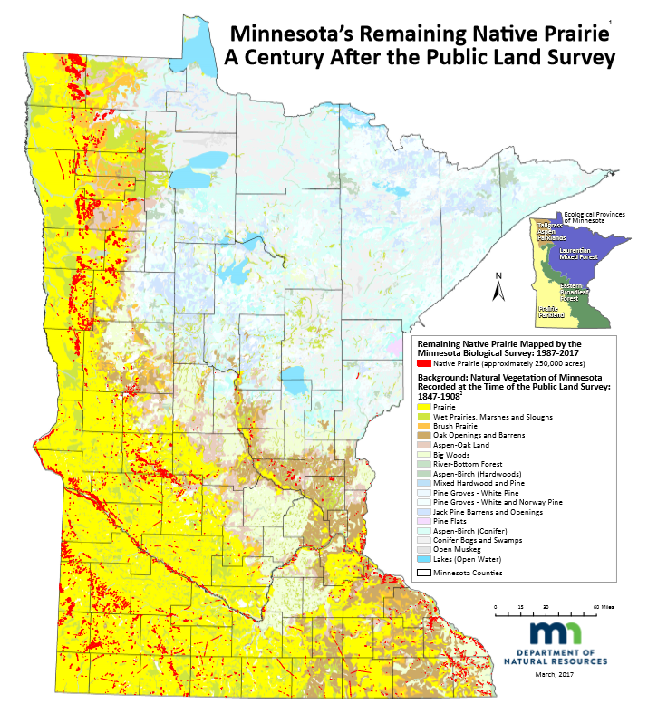

Slide 13
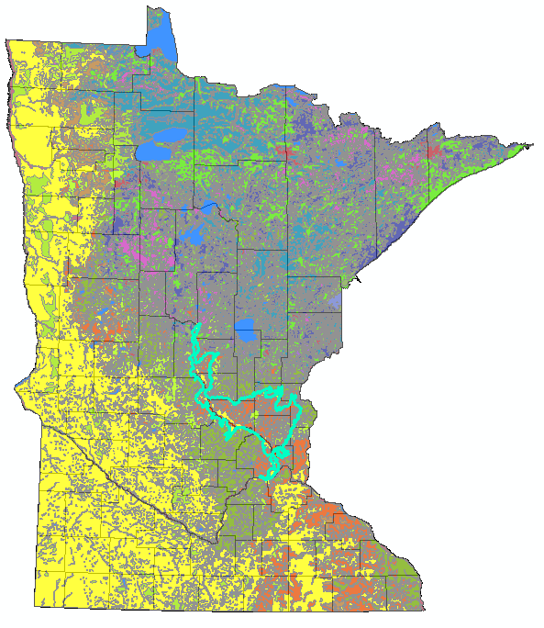
Anoka sand plain

Slide 14
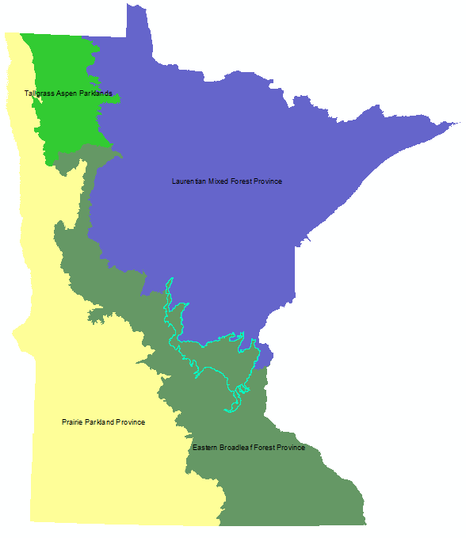
Anoka sand plain

Slide 15
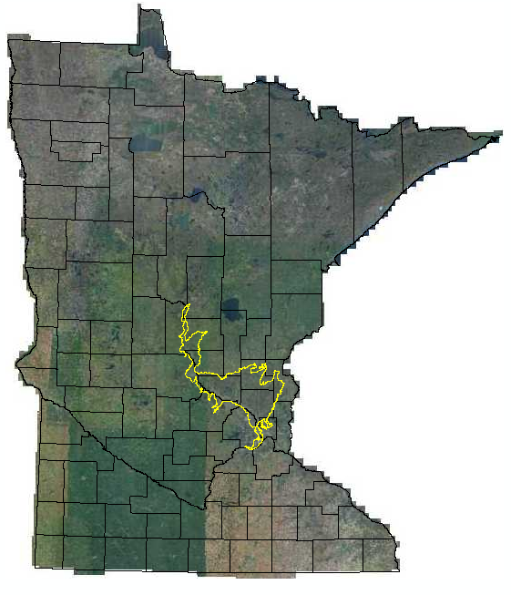
Anoka sand plain

Slide 16
2006 State Wildlife Action Plan
Anoka Sand Plain
High-quality oak savanna, prairie, and dune
97 Species in Greatest Conservation Need
39 federally or state listed species
Rare species occurrence tied to conservation management lands

Slide 17
2006 State Wildlife Action Plan
Anoka Sand Plain
Key challenges for rare species:
Habitat loss
Habitat fragmentation
Habitat degradation
Notes:
In recognizing these challenges, the DNR also saw an opportunity for conservation. <<cut to Sand Dunes>>

Slide 18
Anoka Sand Plain

Slide 19
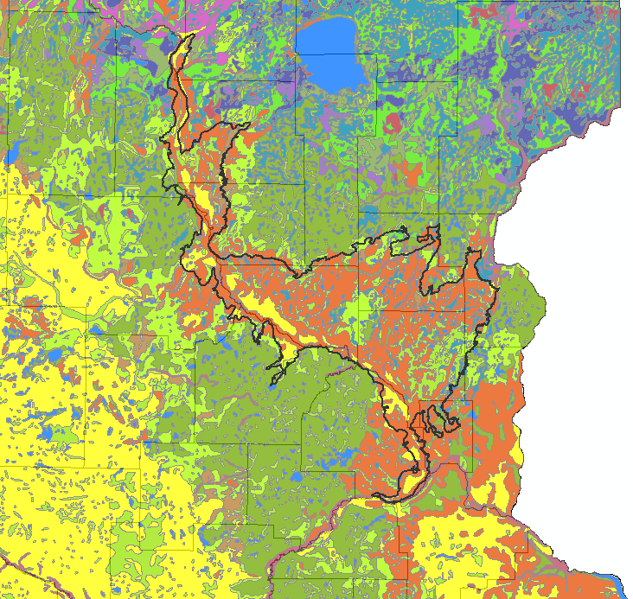
Anoka Sand Plain

Slide 20
Anoka Sand Plain

Slide 21
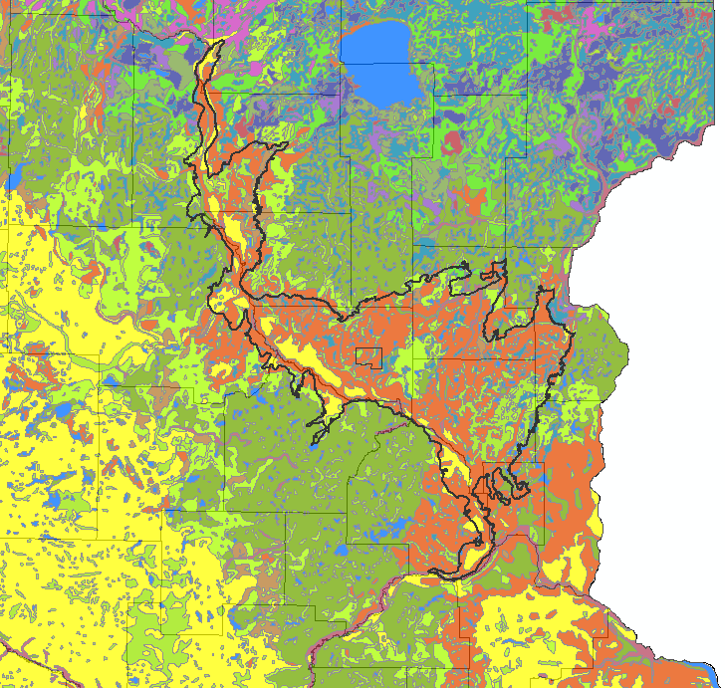
Sand Dunes State Forest
Notes:
Located in central Sherburne county within the Anoka Sand Plain subsection.

Slide 22
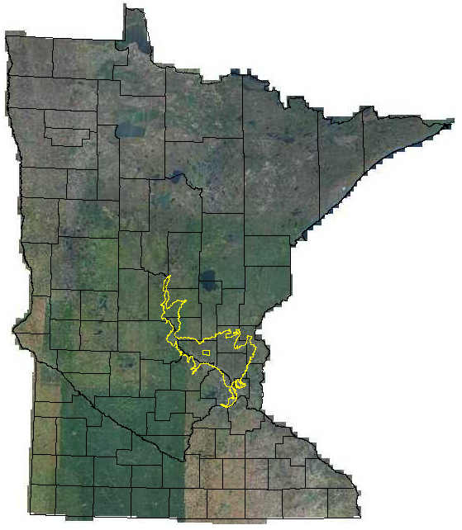
Anoka sand plain

Slide 23
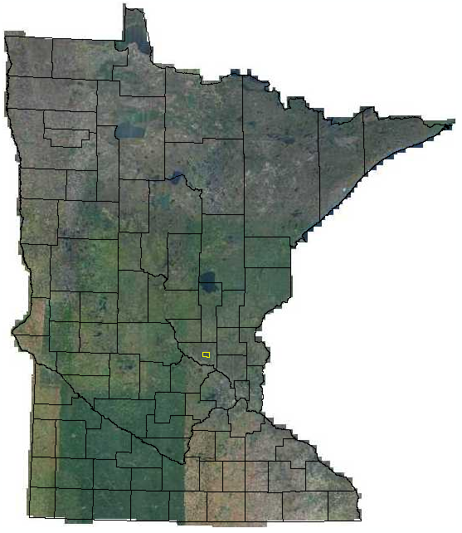

Slide 24
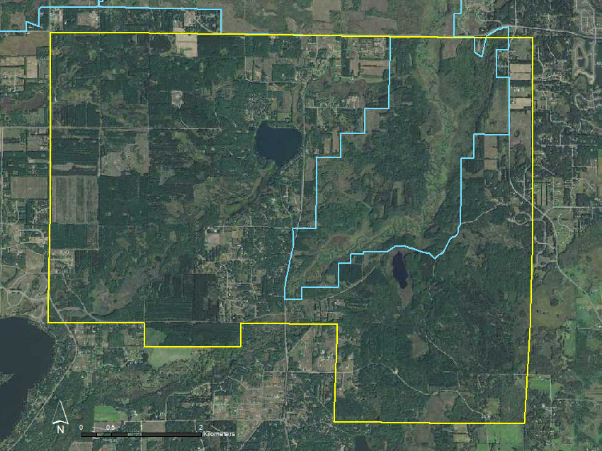
Notes:
Acquired by MN DNR in 1946, encompasses approx. 4,486ha. Managed primarily for recreation and timber production. Pines were planted in the area even before it was state owned to help stabilize dunes and soils during drought years, and have been planted since then because it’s a great area for growing pine for timber.

Slide 25
Sand Dunes State Forest
Rare features.

Slide 27
Sand Dunes Habitat Restoration
Increase available habitat
Improve habitat quality and connectivity
Permanently manage for rare plant and animal species

Slide 28
Sand Dunes Habitat Restoration
Ecologically appropriate native plant communities
Immediate Conversion Areas: 255 ha
Eventual Conversion Areas: 537 ha

Slide 29
Sand Dunes Habitat Restoration
Prescribed burning
Selective timber harvest
Invasive species control

Slide 30
Sand Dunes State Forest

Slide 31
Sand Dunes State Forest
Immediate Conversion Areas:
255 ha

Slide 32
Sand Dunes State Forest
Immediate Conversion Areas:
255 ha
Eventual Conversion Areas:
537 ha

Slide 33
Sand Dunes Habitat Restoration
Rare features management on varying spatial and temporal scales
Broad ecosystem health
Notes:
The goal of this restoration was to manage the landscape for rare native species and communities, and to contribute to the overall broad-scale ecosystem health.

Slide 34
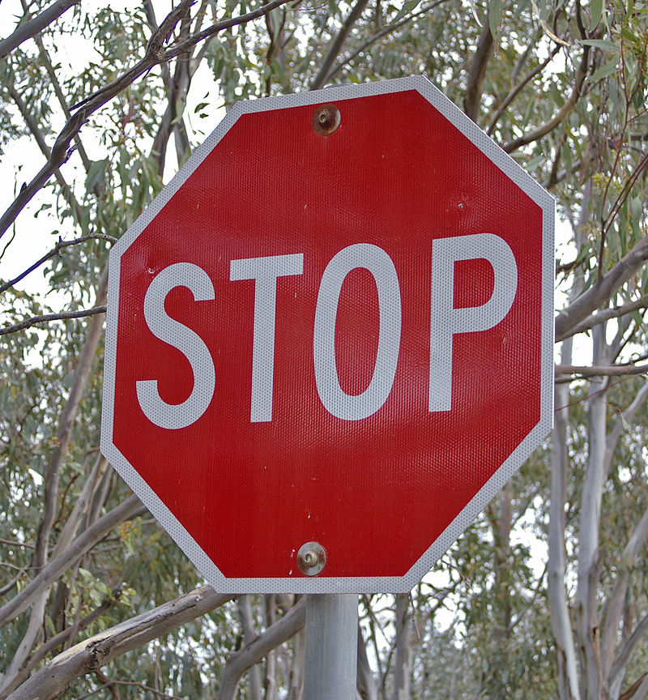

Slide 35
What constitutes success?

Slide 36
Notes:
These are species that evolved along with the native habitats that we are trying to restore. So, we can use their collective distribution, abundance, and response to management as a way to inform restoration.

Slide 37
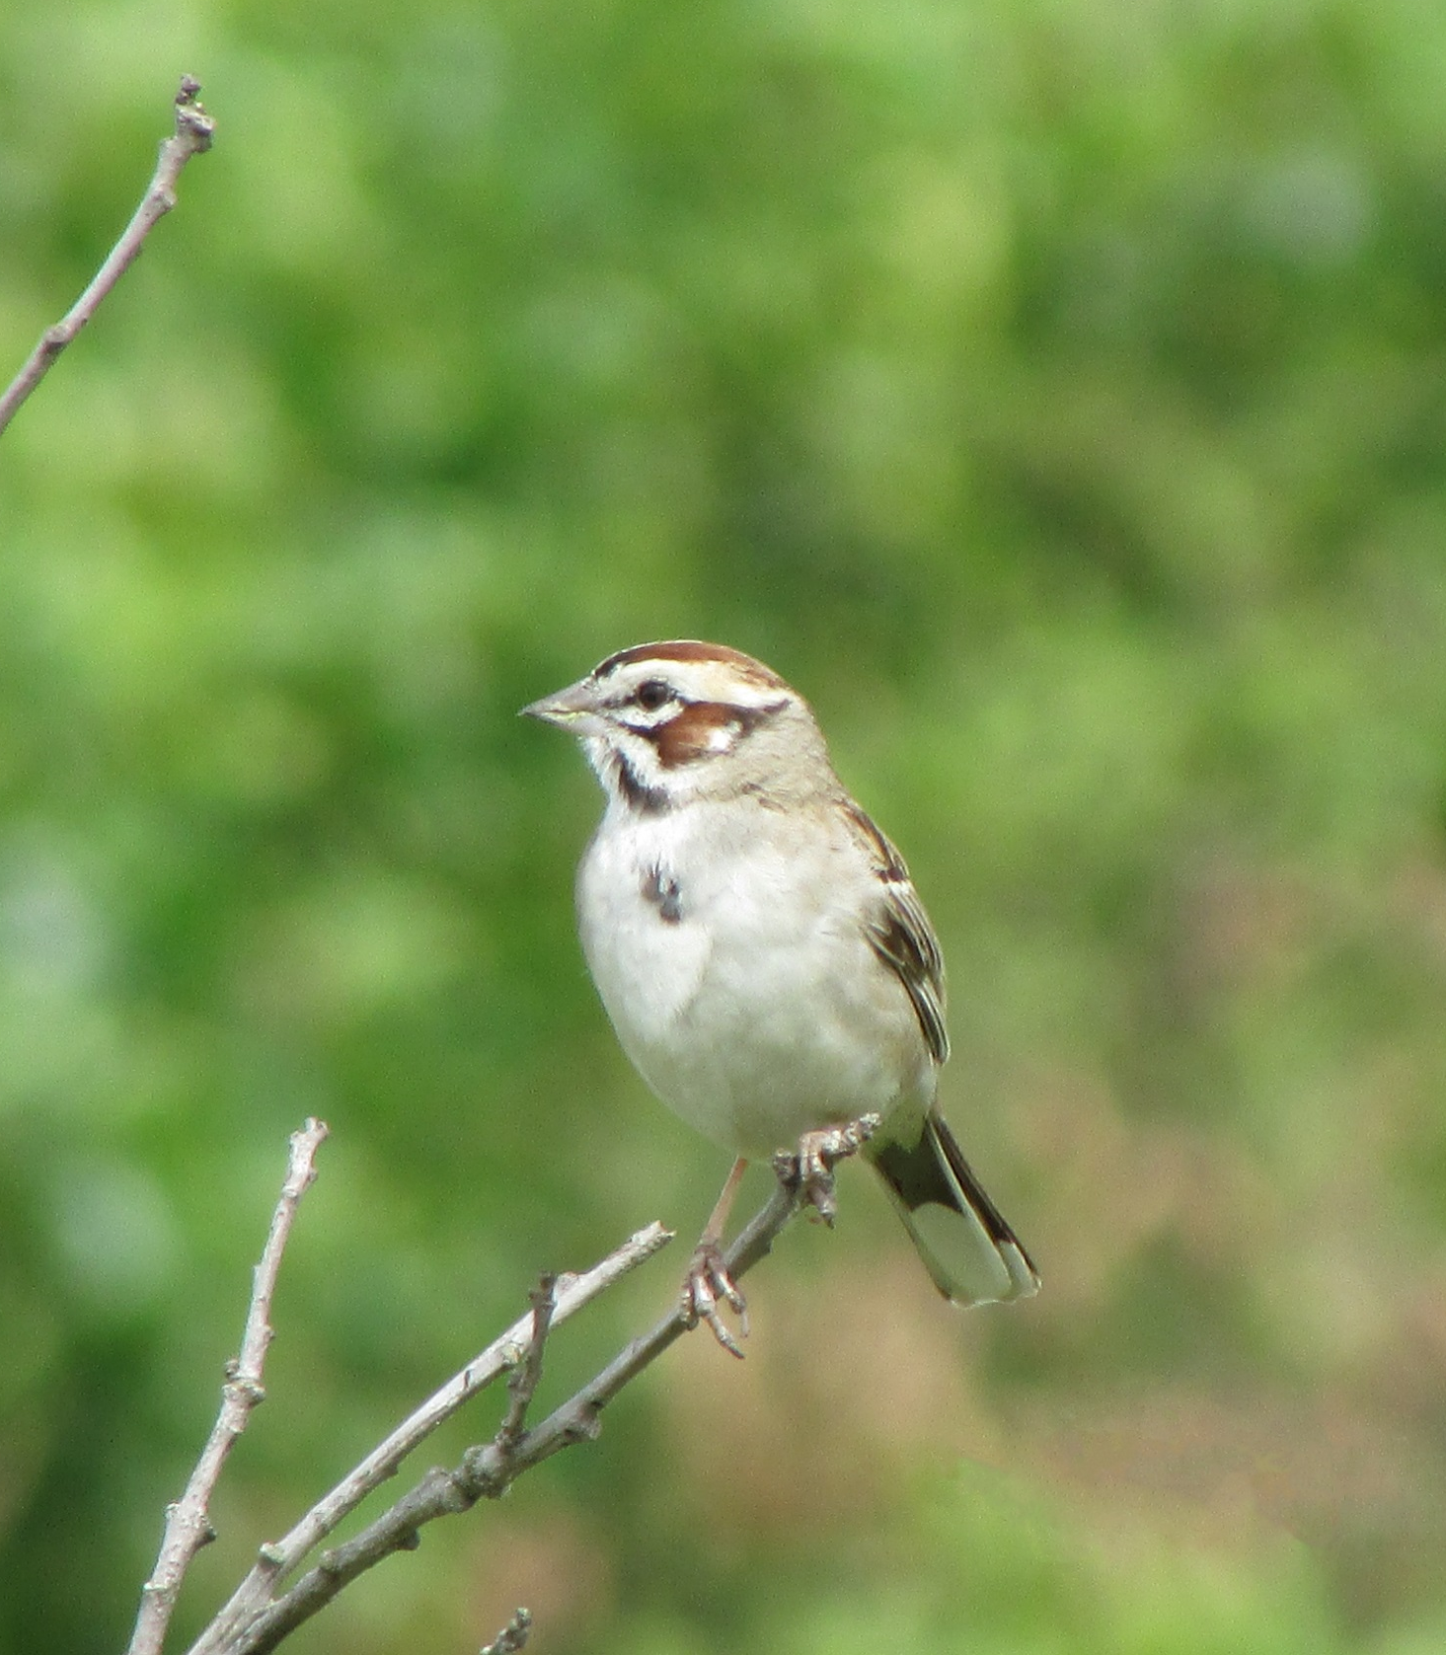
Lark Sparrow
Chondestes grammacus
SGCN
Special Concern

Slide 38
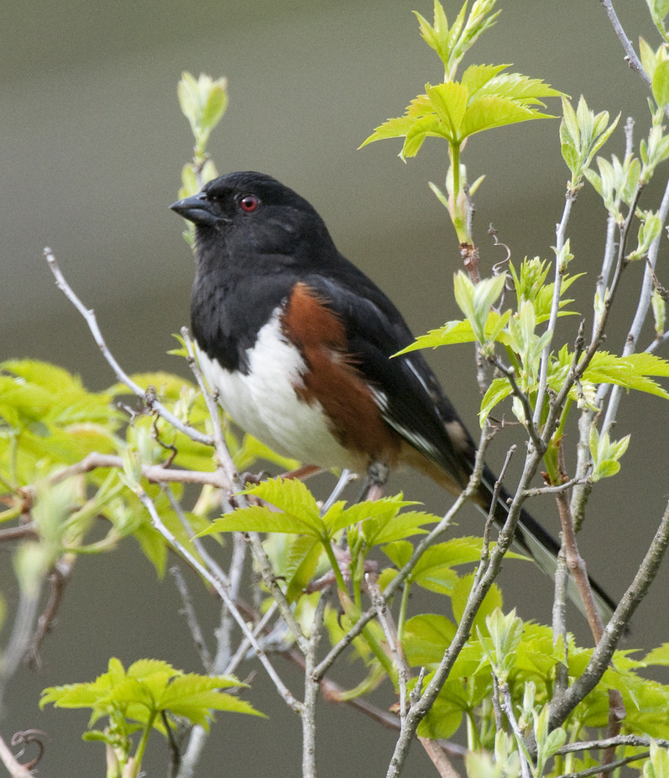
Eastern Towhee
Pipilo erythrophthalmus

Slide 39

Leonard’s Skipper
Hesperia leonardus
SGCN
Special Concern

Slide 40
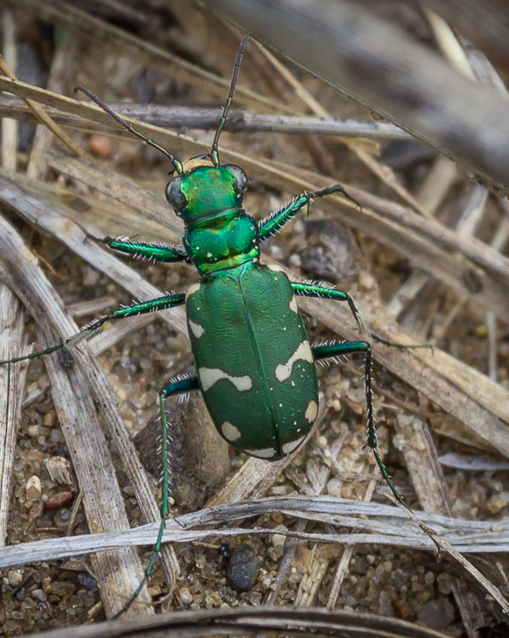
Northern Barrens Tiger Beetle
Cicindela patruela patruela
SGCN
Special Concern
Photo Credit: Brett Whaley

Slide 41
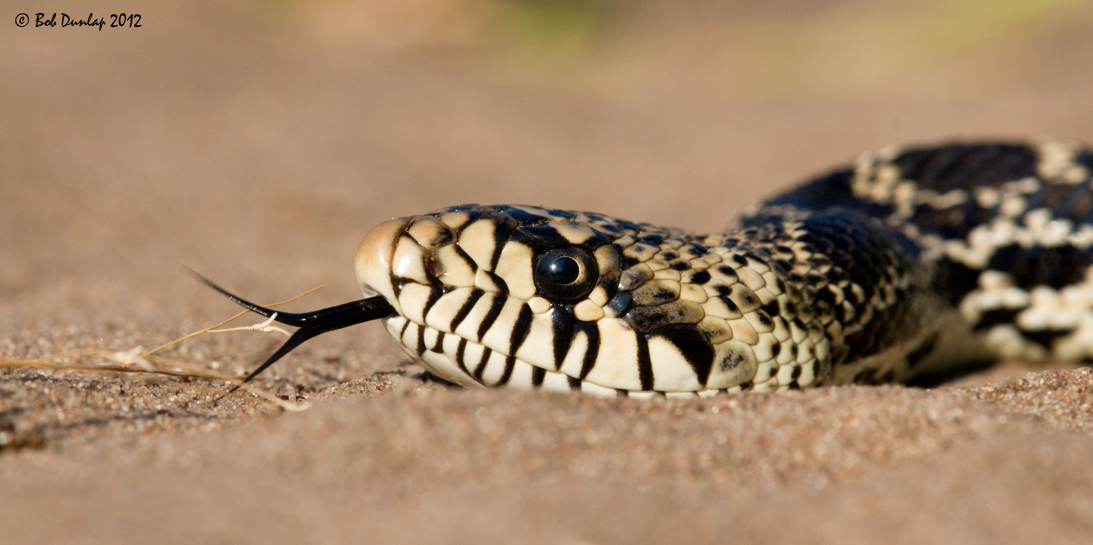
Gophersnake
Pituophis catenifer
SGCN

Slide 42
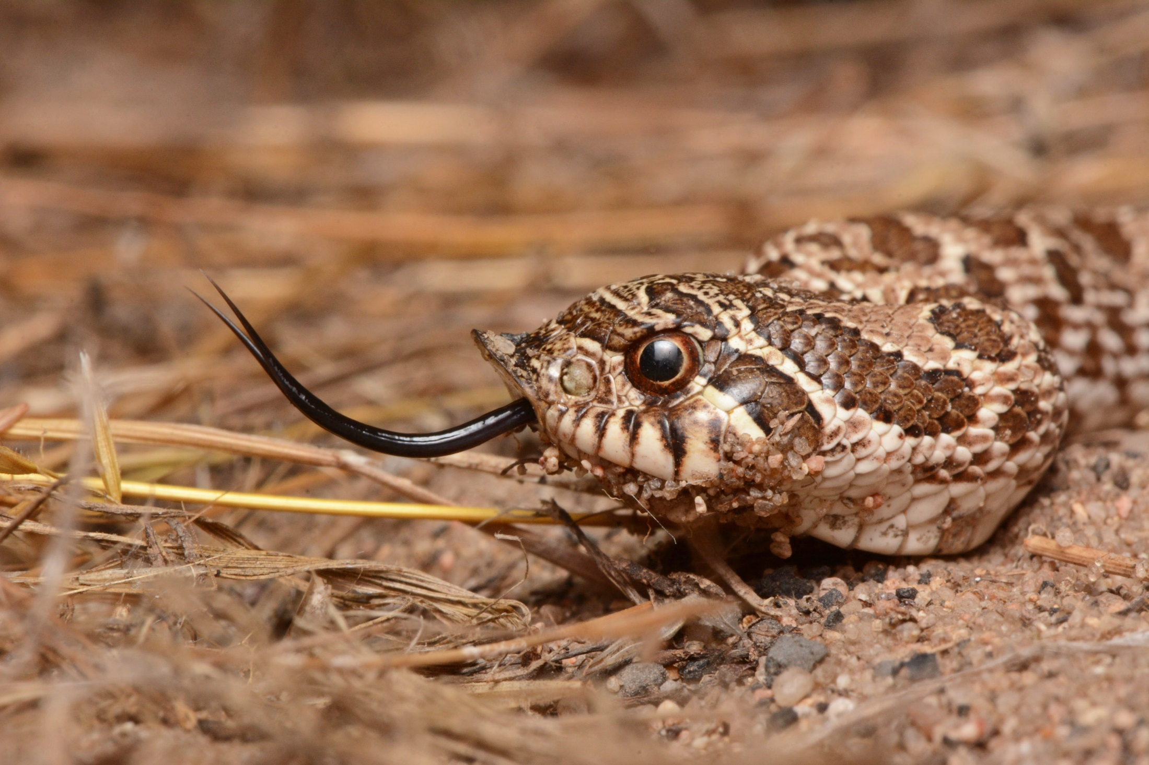
Plains Hognose Snake
Heterodon nasicus
SGCN
Special Concern
Photo Credit: Andrew DuBois

Slide 43
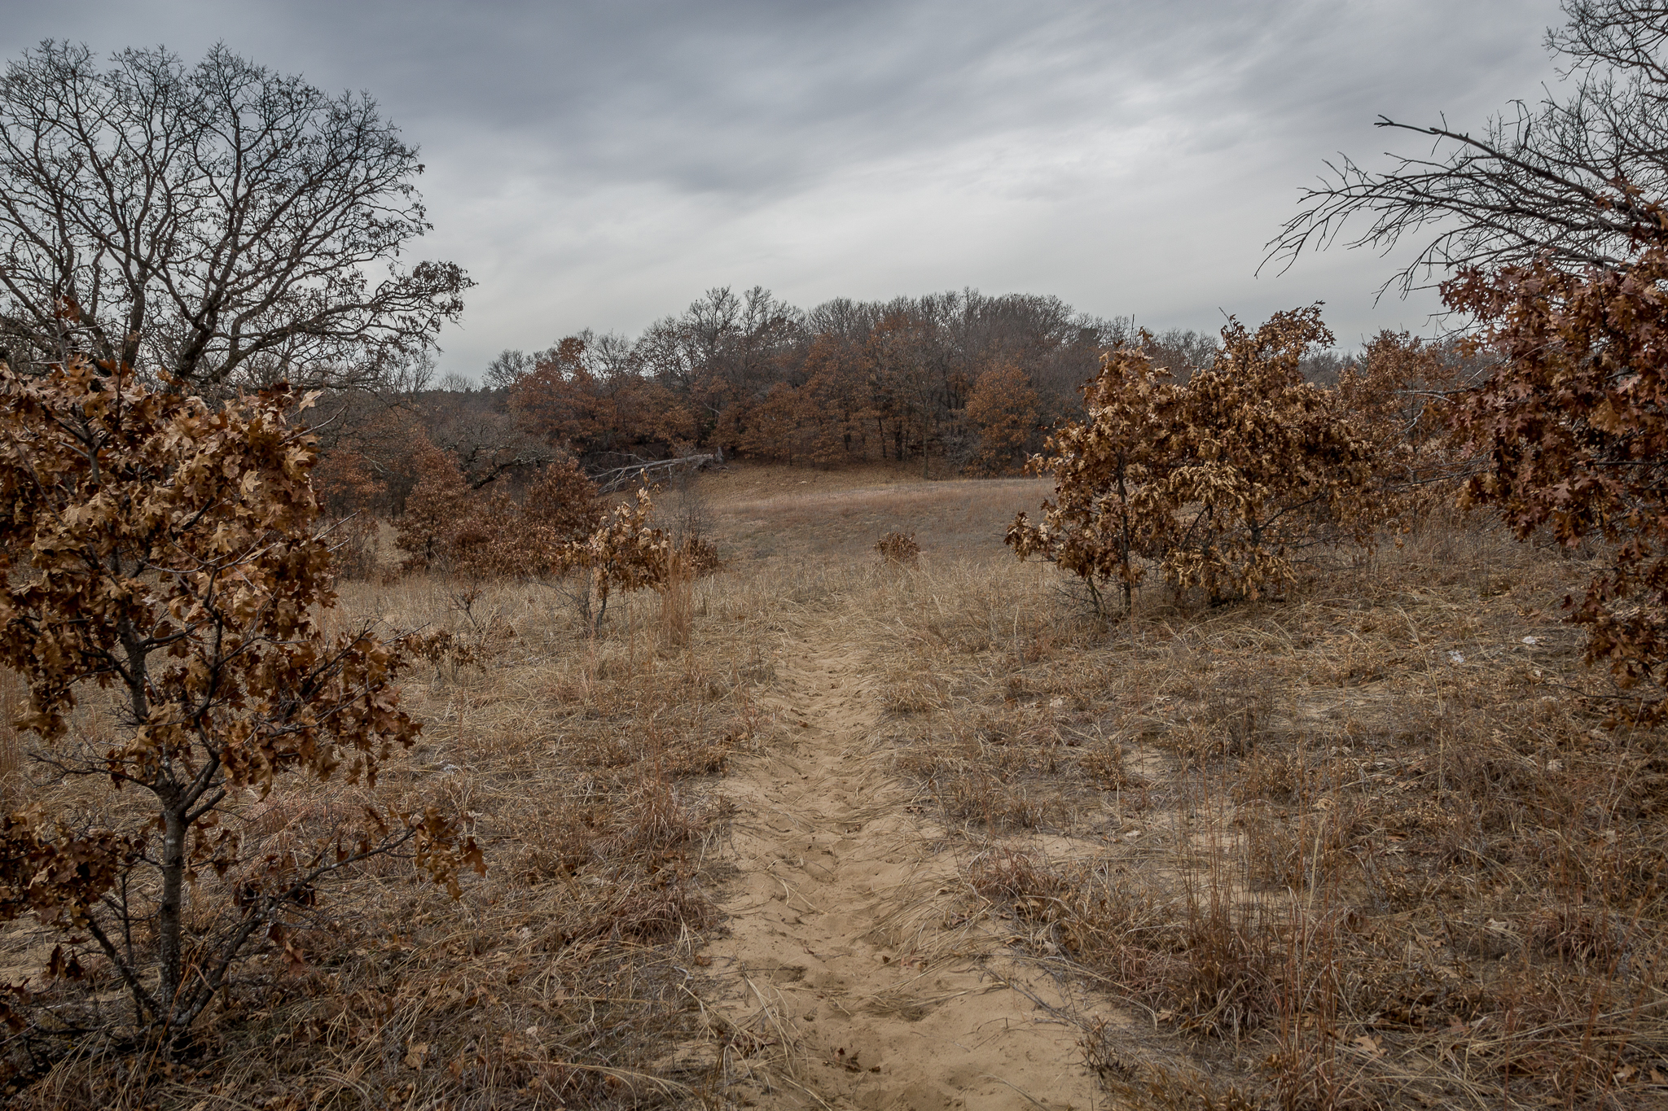
Photo Credit: Brett Whaley
Notes:
We can study the distribution and abundance of these species on the landscape in order to learn more about their habitat requirements, so that we know how to manage for a functional landscape that provides what they need. And that’s exactly what we did.

Slide 44
Photo Credit: Brett Whaley
What factors influence rare species occupancy and abundance on the
Anoka Sand Plain?
Notes:
Our specific research question was, what factors influence rare species occupancy and abundance within the Anoka Sand Plain?

Slide 45
Notes:
Our study area included Sand Dunes State Forest, as a primary goal was to inform habitat restoration within the State Forest Itself. We also included surveys within adjacent Sherburne WMA to add power to our analyses.

Slide 46
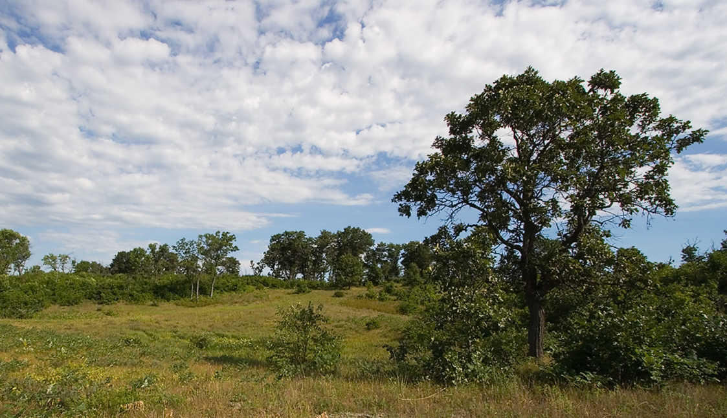
Sherburne National Wildlife Refuge
Notes:
Sherburne is directly North of sand dunes, and has been managed for wildlife since the 1960s. 12,424 ha. For the purposes of our study, Sherburne contains areas that are similar to the desired future conditions at Sand Dunes, and including plots at Sherburne adds…breadth? Scope? What?

Slide 47
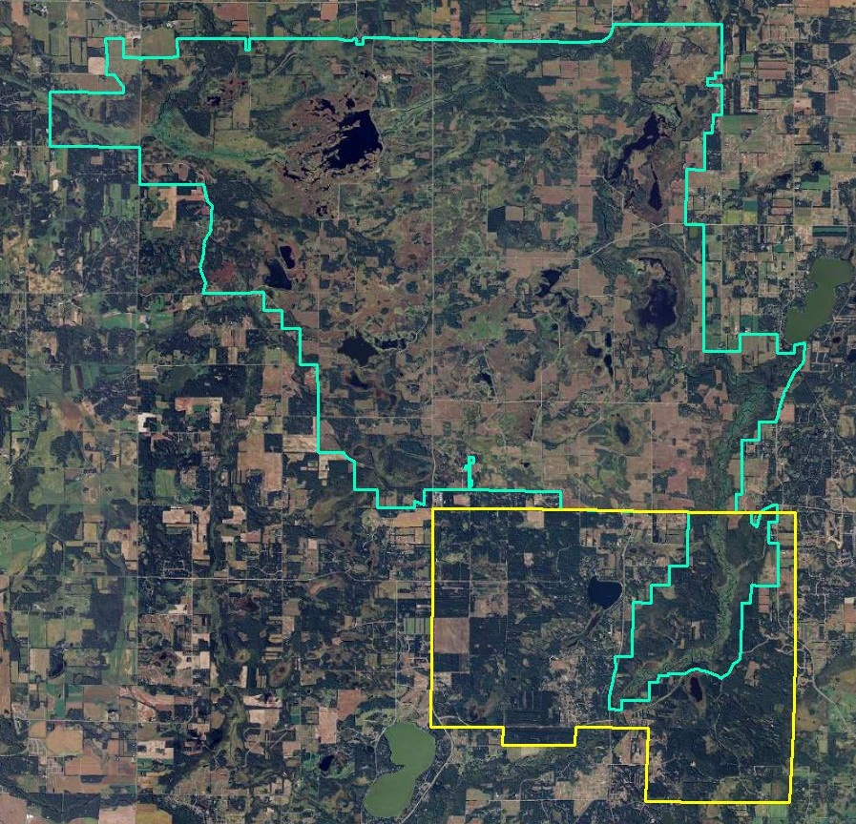
Sherburne
National Wildlife Refuge
~ 12,424 ha
Sand Dunes
State Forest
~ 4,468 ha

Slide 48
Sherburne
National Wildlife Refuge
20 Plots
Sand Dunes
State Forest
39 Plots

Slide 49
Sand Dunes
State Forest
39 Plots
Immediate Conversion Areas
9 Plots

Slide 50
Notes:
We surveyed each plot for our target species over 2 or 3 field seasons between 2014-2016.

Slide 51
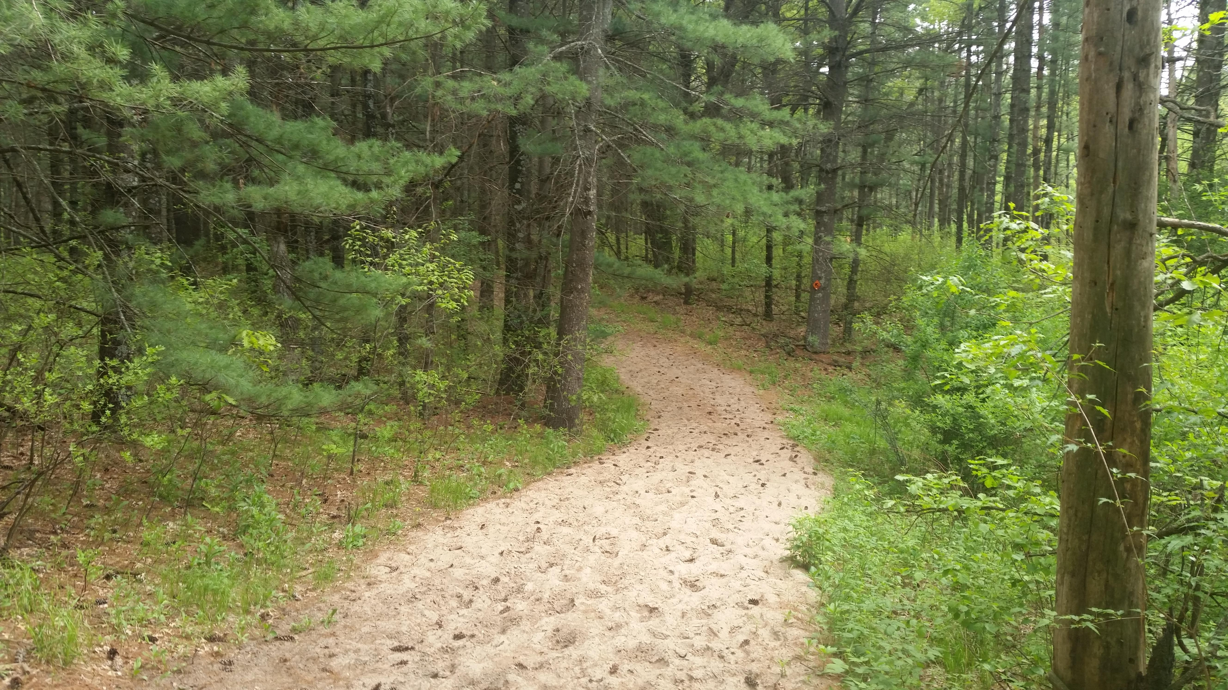

Slide 52
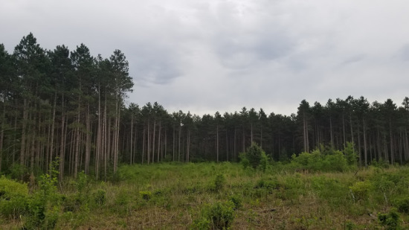

Slide 53
Notes box
Photo Credit
Twenty point text
Twenty-four point text
Twenty-eight point text
Thirty-two point text
Thirty-six point text
Forty-four point text
Forty-eight point text

Slide 54
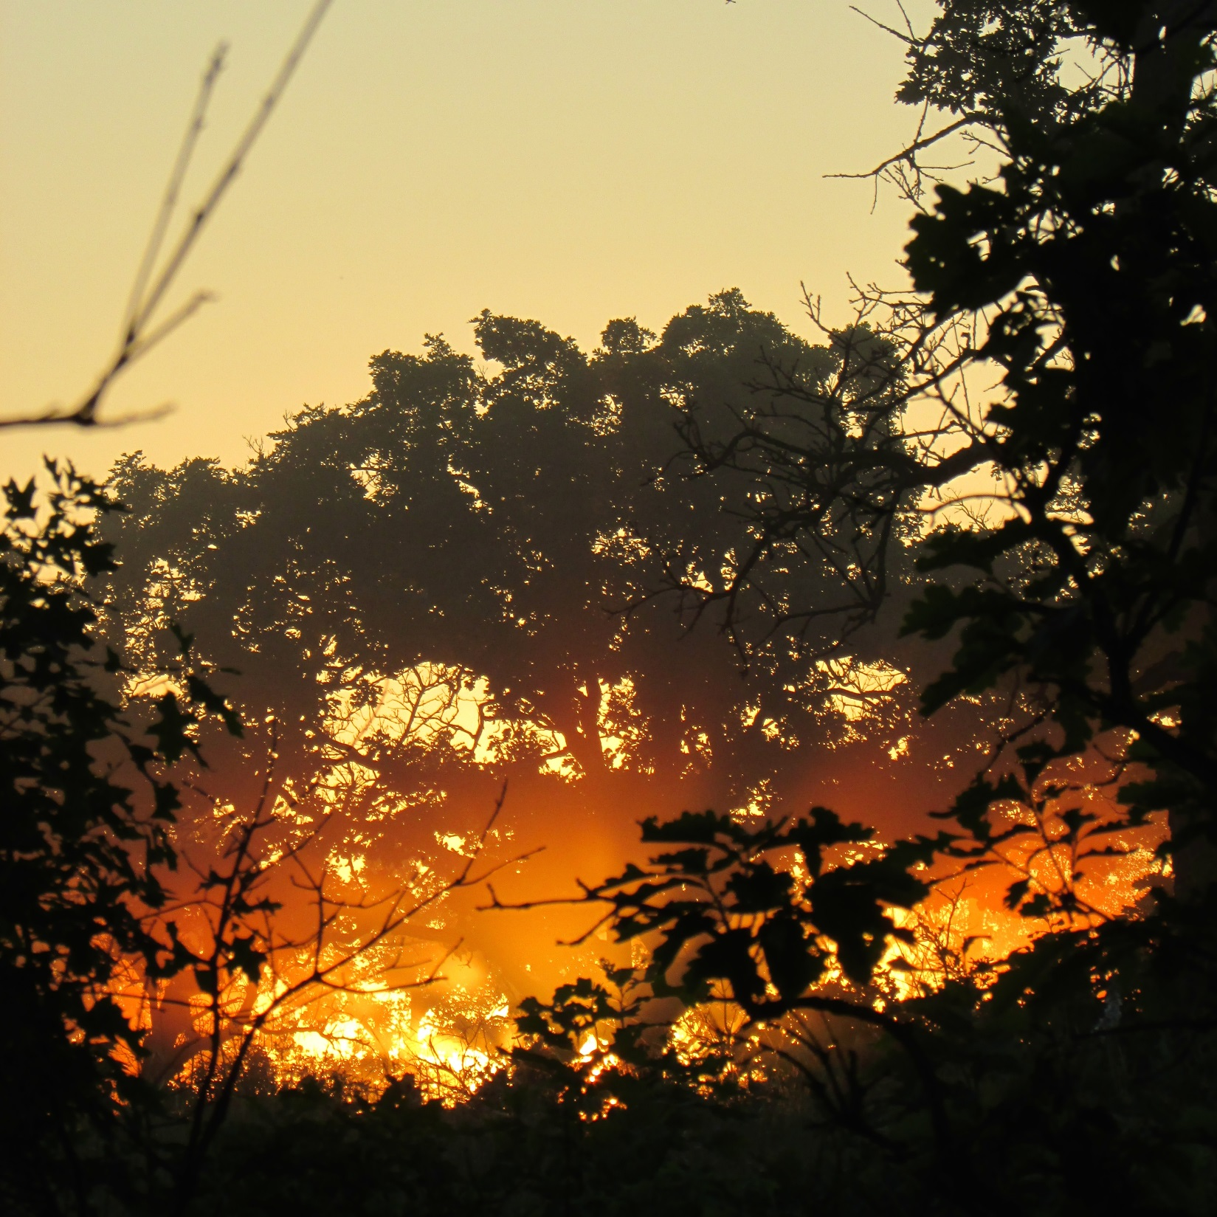

Slide 55
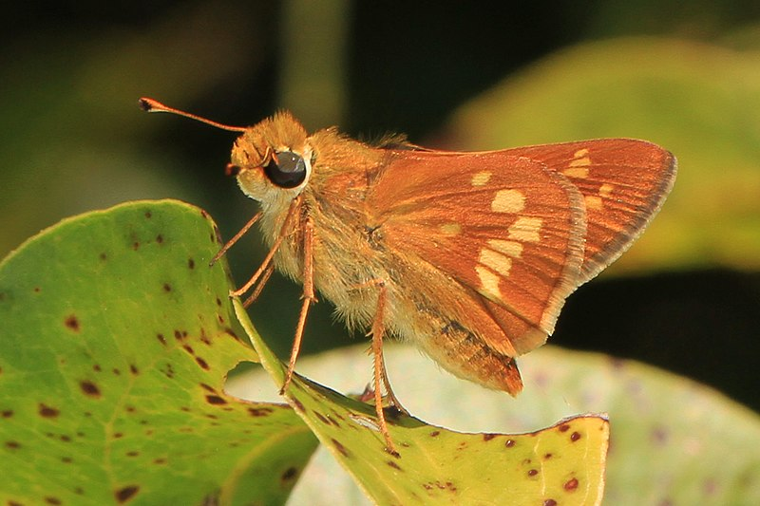
Judy Gallagher

Slide 59
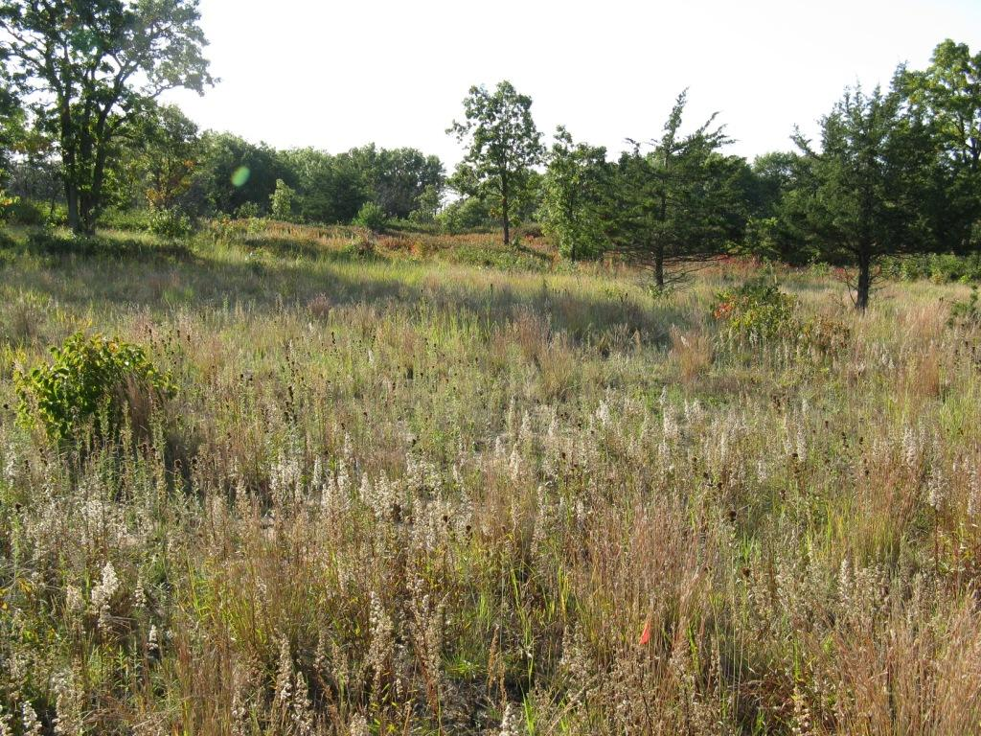

Slide 60
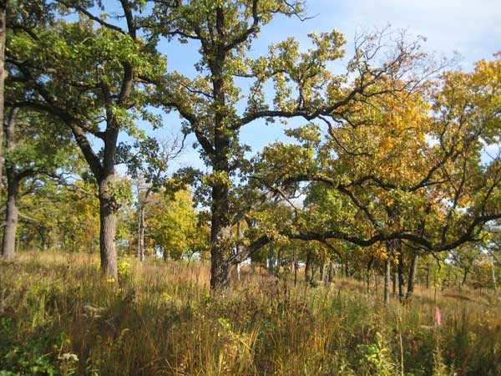

Slide 61
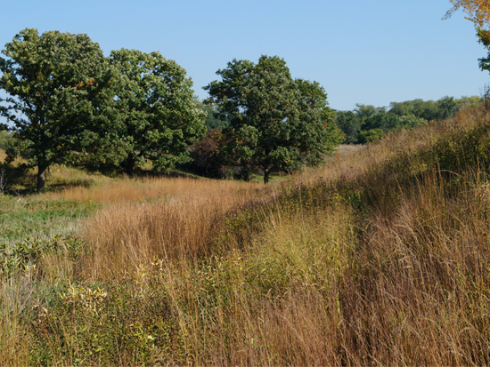

Slide 62
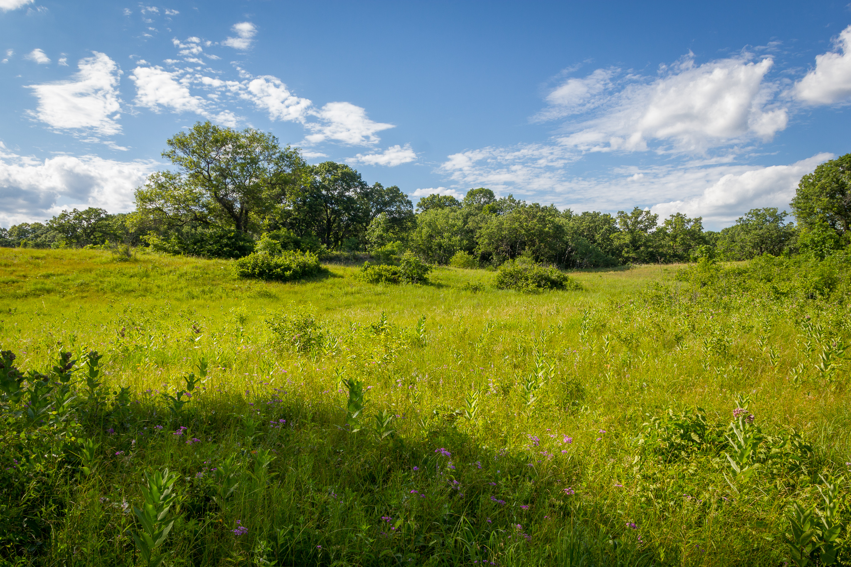

Slide 63
